Slide 1
MGMT-6064 PROJECT LEADERSHIP AND MANAGEMENT
Module 11: Communication

Slide 2

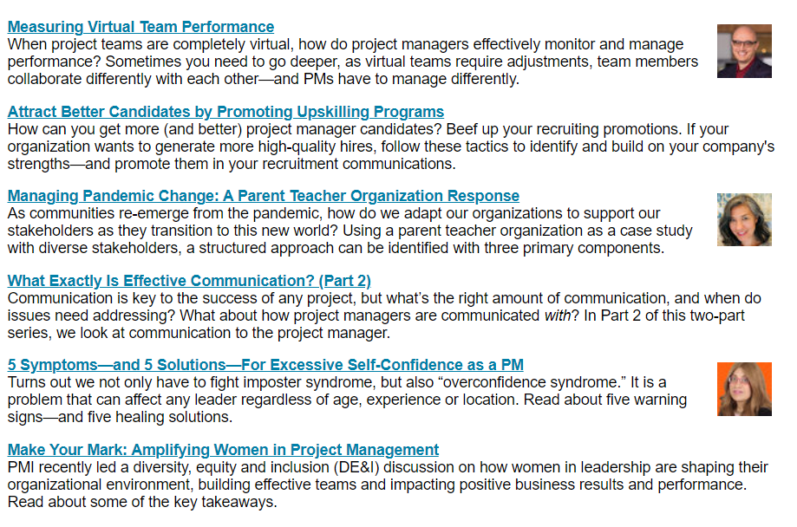

FYI: Our course concepts are Hot Topics for project managers!

Slide 3
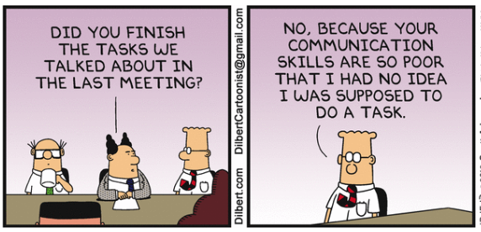
topics
Communication model
Importance of nonverbal communication
Barriers to effective communication
Improving interpersonal communication
Notes:
Dilbert sources: https://assets.amuniversal.com/91c036108ed50137ae6d005056a9545d and https://assets.amuniversal.com/1c92c10016570130ff3e001dd8b71c47
Unless otherwise stated in the slide notes, all material in this slideshow come from: Dessler, G. & Starke, F.A. (2004). Management: Principles and practices for tomorrow's leaders (2nd Canadian ed.). Toronto: Pearson Education Canada. [pp. 412-419, 435-436]

Slide 4

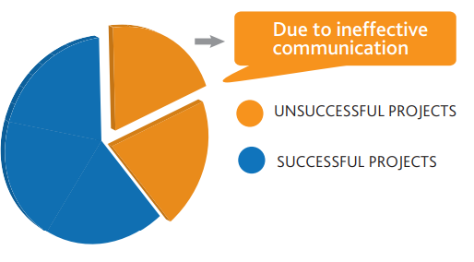
Communication is often referred to as the backbone of project management – some experts say that “communication is 90% of a Project Manager’s job” - PMI
“Project teams were asked what makes (one) project succeed. Over 95% of team members said that good communication was the reason for their success. Over 95% said that poor communication was the reason for their failures. Clearly communication appears to be the key to project success.” - Sue Dyer
“One out five projects is unsuccessful due to ineffective communications.” - PMI
Notes:
Image: https://www.taxconnections.com/taxblog/wp-content/uploads/TaxConnections-Picture-Expert-Advice-square-1024x1024.jpg
Dyer quote: https://dyerpredictions.typepad.com/
90% of PM job is communication - source: https://www.pmi.org/learning/library/effective-communication-better-project-management-6480
1 out of 5 projects fails due to ineffective communications: PMI 2013 Pulse of the Profession - https://www.pmi.org/-/media/pmi/documents/public/pdf/learning/thought-leadership/pulse/the-essential-role-of-communications.pdf?v=e1f0e914-4b3a-456f-b75e-40101632258b&sc_lang_temp=en – where success is measured as meeting project goals, on time, within budget; according to PMI Pulse of the Profession research, 2 in 5 projects ‘fail’

Slide 5
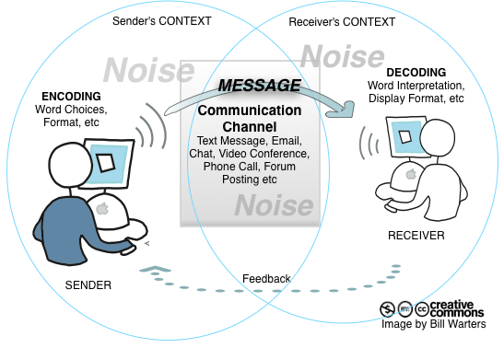
Communication model
Most communication models include the following components:
Sender
Message
Encoding
Medium
Receiver
Decoding
Feedback
Noise
Notes:
Image: https://2minutemom.files.wordpress.com/2016/05/communicationmodeldiagram.png?w=663
In our assigned reading from Dessler and Starke, the authors use some slightly different terms: ‘information source’ instead of ‘message’, and ‘signal’ instead of ‘encoding’

Slide 6

What is ‘noise’?
Anything that blocks, distorts, or changes the message from the receiver to the sender
Noise can occur anywhere in the communication model
Notes:
Image: http://www.allthingscahill.com/wp-content/uploads/2016/08/Communication-Breakdown.jpg

Slide 7
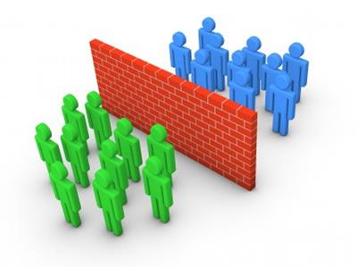
communication barriers
Ambiguous messages
Semantics
Physical barriers
Loss of transmission
Failing to communicate
Competition
Cultural, linguistic, diversity barriers (e.g., video)
Psychological barriers
Notes:
Video is 5:24 min

Slide 8

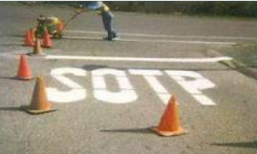

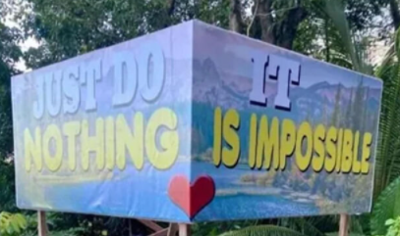

communication mistakes are communication messages
Your/you’re
There/their/they’re
It’s/its
Then/than
Commas

Slide 9

psychological barriers to effective communication
Perception
Experiential barriers
Emotions
Defensiveness
Notes:
Image: https://image.slidesharecdn.com/communicationstyle-170518131521/95/communication-style-1-638.jpg?cb=1495113540

Slide 10

Non-verbal communication
Facial expressions
Eye contact
Posture/body language (e.g., crossed arms, leaning forward/backward, mirroring gestures of the other person)
Paralinguistics (e.g., tone of voice, inflection, speaking softly to calm someone down)
Proxemics (personal space)
Haptics (communicating through touch)
Notes:
Proxemics is pronounced: prahk-SEE-micks
Image: https://image.slidesharecdn.com/difficultconversations-1223565386974051-9/95/having-difficult-conversations-1-728.jpg?cb=1223540252

Slide 11

General tips for Improving interpersonal communications
Pay attention (to improve sharing of understanding)
Be clear with words
Make sure tone, expression, words are all consistent
Be an active listener
Avoid putting the person ‘on the defensive’
Be prepared to back up your assertions with evidence
Notes:
Image: https://www.gsb.stanford.edu/sites/gsb/files/Feedback%20sidebar.

Slide 12


Tips for written and oral communication
Written:
Write for your audience
Edit for grammar
Be concise
Be mindful of using overcomplicated words/phrases
Oral:
Speak up!
Try to achieve rapport
Eye contact
Use gestures and physical space
Use notes minimally
‘Read’ your audience
Emphasize important points
Channel nervousness into enthusiasm
Notes:
Image: https://contentwritingtraining.files.wordpress.com/2013/03/content-writing-9.jpg
https://www.quickanddirtytips.com/sites/default/files/images/1329/speech-podium.jpg

Slide 13
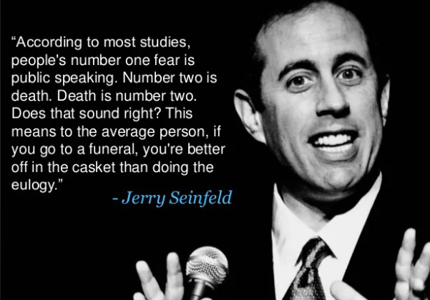

Public speaking is hard!!

Slide 14
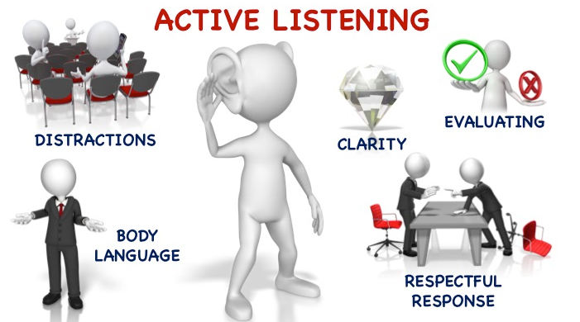
Active listening
Listen to words
Look for non-verbal cues
Do not interrupt
Seek clarification by asking questions if needed
Do not get distracted (focus on the speaker)
Try to understand the speaker’s perspective (keep an open mind)
Process the message while it is being delivered
(video)
Notes:
Video : 2 min
Source: Kerzner, Dessler and Starke excerpt
Image: https://goascend.biz/wp-content/uploads/2017/02/Slide3-3.jpg

Slide 15
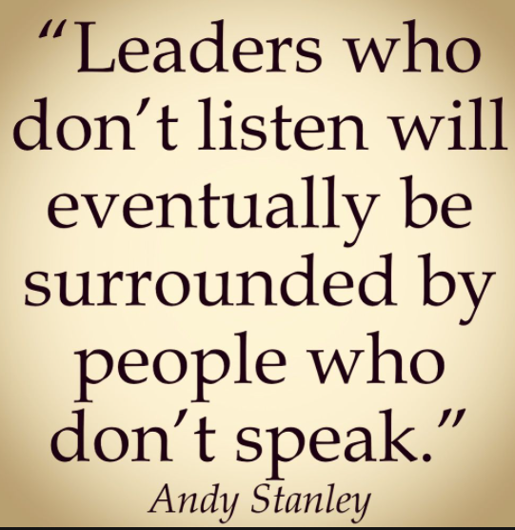
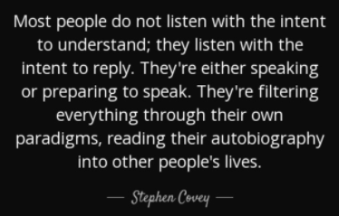

Listen!

Slide 16

Improving your persuasion skills
Establish your credibility
Don’t be stubborn / uncompromising / aggressive
Look for common ground
Connect emotionally
Provide evidence without being overbearing
Use examples, stories, analogies
Be patient, persuasion takes time
(video)
Notes:
Video 12 min
Imagehttps://thumbs.dreamstime.com/b/man-trying-to-sell-his-product-persuading-people-using-persuasion-skill-flat-cartoon-style-45579254.jpg

Slide 17

conclusions
Don’t assume that the message you sent will be received in the form in which you sent it -- eliminate as much “noise” as you can
The most effective communications take place among people who trust each other and have common points of view -- invest in relationship-building!
Good interpersonal communication skills will be one of your ‘superpowers’ as a project manager/team leader -- poor interpersonal communication skills might be your ‘kryptonite’ (a weakness leading to project failure)
Notes:
Source: Kerzner (11th edition)
Image: http://www.webquestcreator2.com/majwq/public/files/files_user/18835/CONCLUSION.jpg

Slide 18
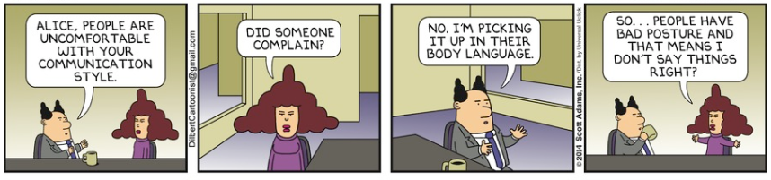
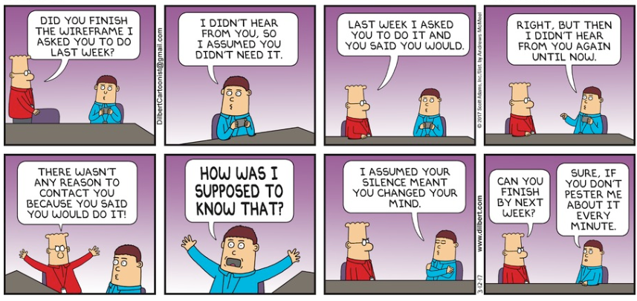
Notes:
Image source: https://assets.amuniversal.com/8c42e220ef7501317f73005056a9545d
https://assets.amuniversal.com/22d2f280b94101366146005056a9545d
Dilbert cartoon source: https://assets.amuniversal.com/1f27c6c0c4fe01343cdb005056a9545d
https://assets.amuniversal.com/2252be60c4fe01343cdb005056a9545d

